Slide 1
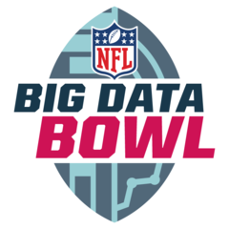
NFL Big Data Bowl
Emily Deuell, Kayla Calvin, Assaf Lowengart

Slide 2
AGENDA
Competition Overview
Notebook Critique
Our Solution
Reasoning
​Summary​

Slide 3
INTRODUCTION:
THE BIG DATA BOWL
Football at baseline:
the offensive goal is to run (rush) or throw (pass) the ball to gain yards, moving towards, then across, the opposing team’s side of the field in order to score.
the defensive goal is to prevent the offensive team from scoring.
In this competition:
you will develop a model to predict how many yards a team will gain on given rushing plays as they happen.
You'll be provided game, play, and player-level data,
Data includes: position and speed of players as provided in the NFL’s Next Gen Stats data.

Slide 4
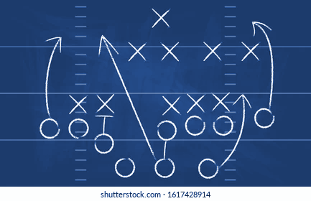
What are we looking for?
What makes a good running play
Predicting rushing yards
using different regression models
Helping coaching staff create better plays
what makes a team win

Slide 5
Code Demo Loading…

Slide 6



Issues with the Other’s Code:
Didn’t Answer the Question
Explainability
Low RMSE Models
Many submissions didn’t actually answer the question
For example, many were attempting to do classification models
These models predicted formations but failed to have insights on rushing yards
Many of the competition had complicated models which failed to articulate what they were doing or why they were it
Clients would have trouble understanding the validity of these models or finding insights
Models had poor performance on predictions
Could be due to the types of models or failure to clean/transform the data well-enough
Notes:
We could also have it be the issues with all three and break down why those things are issues instead of just doing the issues for each individual notebook

Slide 7
Insights
Football is extremely difficult to predict. The number of variables combined with the type of variables makes running analysis a challenging task.
Key insights:
Weather - Snow and rain
Players in the box
Makes sense that this competition was worth over $50,000 for the winner.

Slide 8
Summary
The Big Data Bowl is looking to be able to make better predictions on yards gained based on rushing plays.
The model that marginally performed the best was gbm.
We’d encourage anyone who would like to participate in the competition to use feature engineering if they have background knowledge in football (and lots of time on their hands).

Slide 9
THANK YOU
& GOOD LUCK
ON THE AI EXAM
Assaf Lowengart, Kayla Calvin, Emily Deuell
Team 9

Slide 10
Resources
Howard, A., Reid, J. E., Lopez, M., & Cukierski, W. (2019). NFL Big Data Bowl. Kaggle. Retrieved April 20, 2023, from https://www.kaggle.com/c/nfl-big-data-bowl-2020/overview
seanyman84. (2020, March 14). NFL rush prediction. Kaggle. Retrieved April 20, 2023, from https://www.kaggle.com/code/seanyman84/nfl-rush-prediction

